Slide 1

Chapter 17
Introduction
to the
Application
Layer
Copyright © The McGraw-Hill Companies, Inc. Permission required for reproduction or display.

Slide 2
OBJECTIVES:
To introduce client-server paradigm.
To introduce socket interfaces and list some common functions in this interface.
To discuss client-server communication using connectionless iterative service offered by UDP.
To discuss client-server communication using connection-oriented concurrent service offered by TCP.
To give an example of a client and a server program using UDP.
To give an example of a client and a server program using TCP.
To briefly discuss the peer-to-peer paradigm and its application.

Slide 3
Chapter
Outline
17.1 Client-Server Paradigm
17.2 Peer-to-Peer Paradigm

Slide 4
17-1 CLIENT-SERVER PARADIGM
The purpose of a network, or an internetwork, is to provide services to users: A user at a local site wants to receive a service from a computer at a remote site. One way to achieve this purpose is to run two programs. A local computer runs a program to request a service from a remote computer; the remote computer runs a program to give service to the requesting program. This means that two computers, connected by an internet, must each run a program, one to provide a service and one to request a service.

Slide 5
Topics Discussed in the Section
Server
Client
Concurrency
Socket Interfaces
Communication Using UDP
Communication Using TCP
Predefined Client-Server Applications

Slide 6
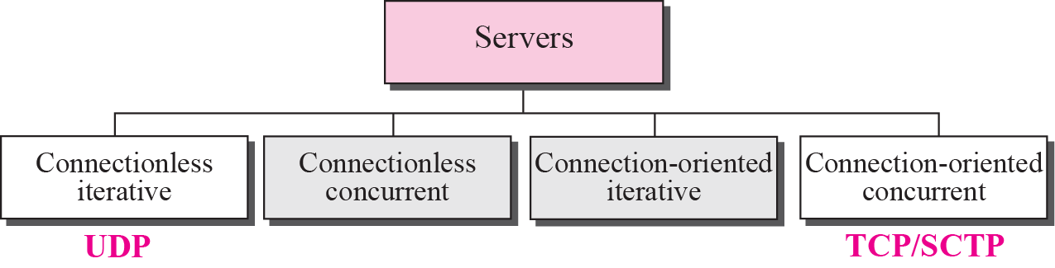
Figure 17.1 Server types

Slide 7
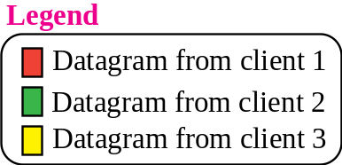
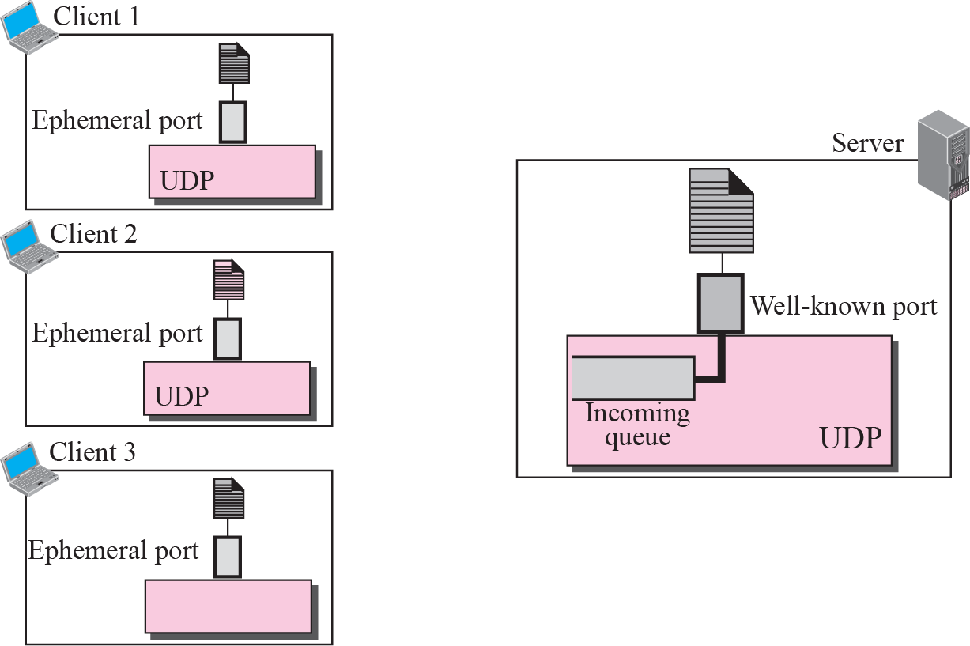

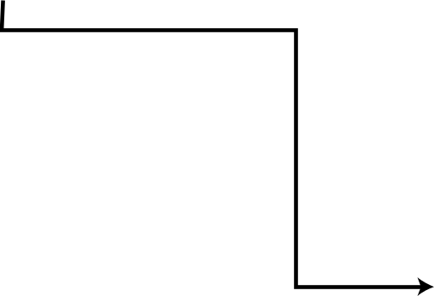

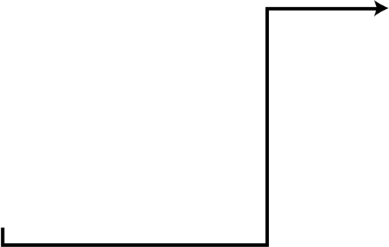
Figure 17.2 Connectionless iterative server

Slide 8
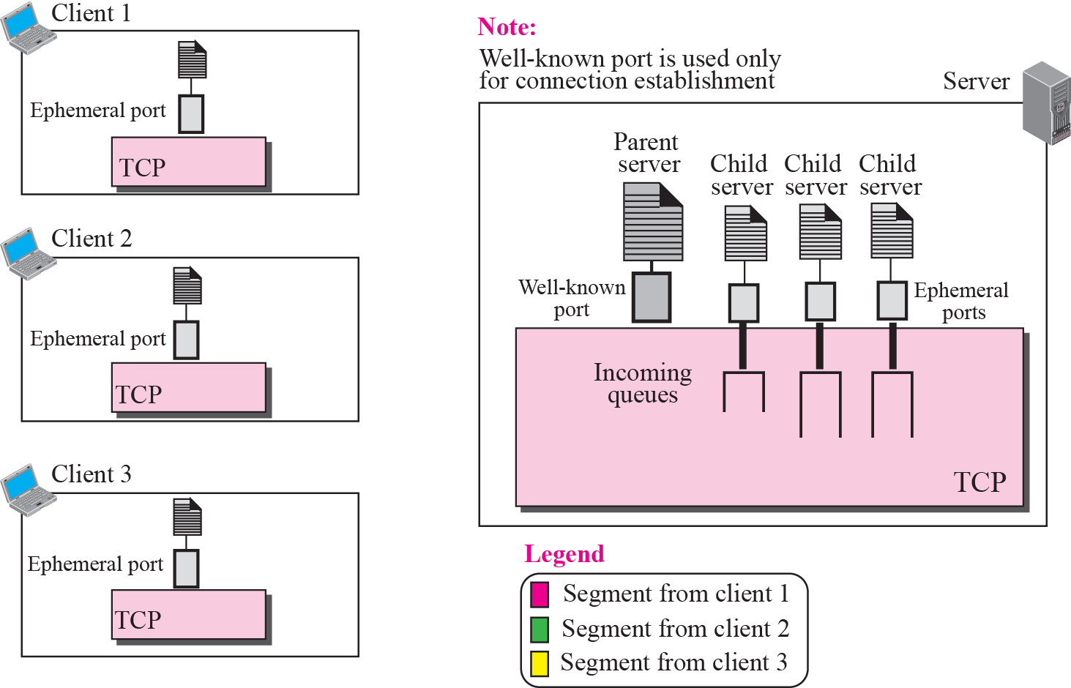
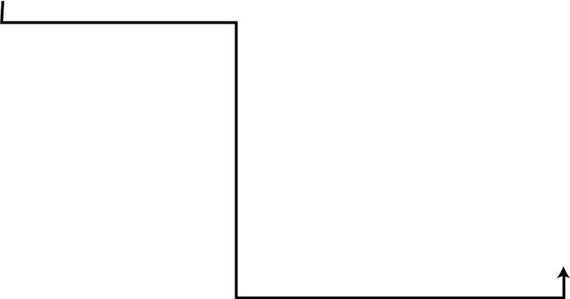

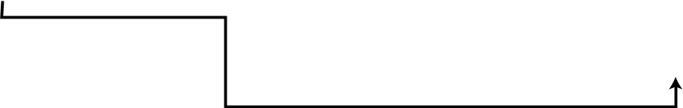

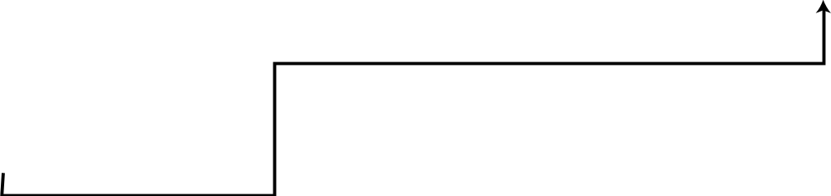
Figure 17.3 Connection-oriented concurrent server

Slide 9

Note
An interface is a set of instructions designed for interaction between two entities.

Slide 10
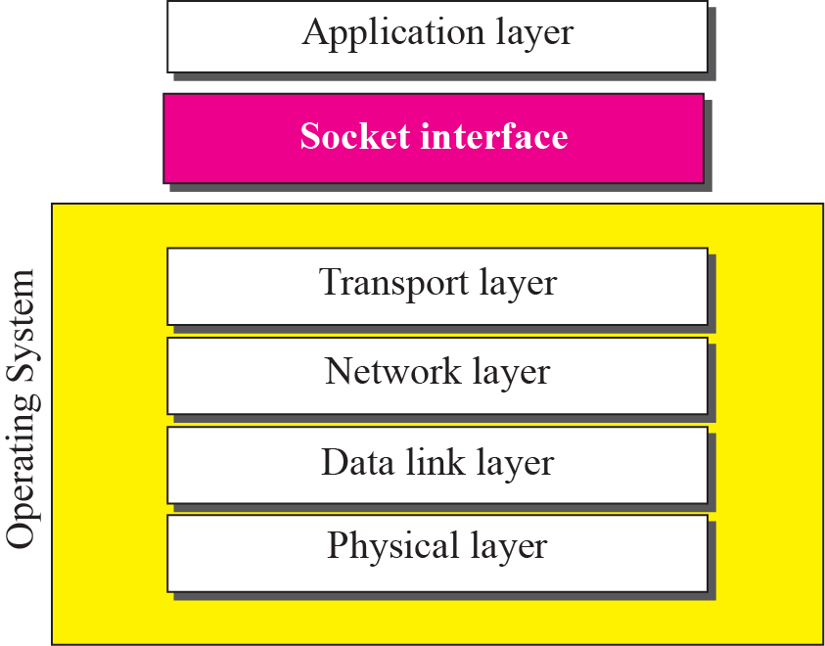
Figure 17.4 Relation between the operating system and the TCP/IP suite

Slide 11
Example 17.1
Most of the programming languages have a file interface, a set of instructions that allow the programmer to open a file, read from the file, write to the file, perform other operations on the file, and finally close the file. When a program needs to open the file, it uses the name of the file as it is known to the operation system. When the file is opened, the operating system returns a reference to the file (an integer or pointer) that can be used for other instructions, such as read and write.

Slide 12
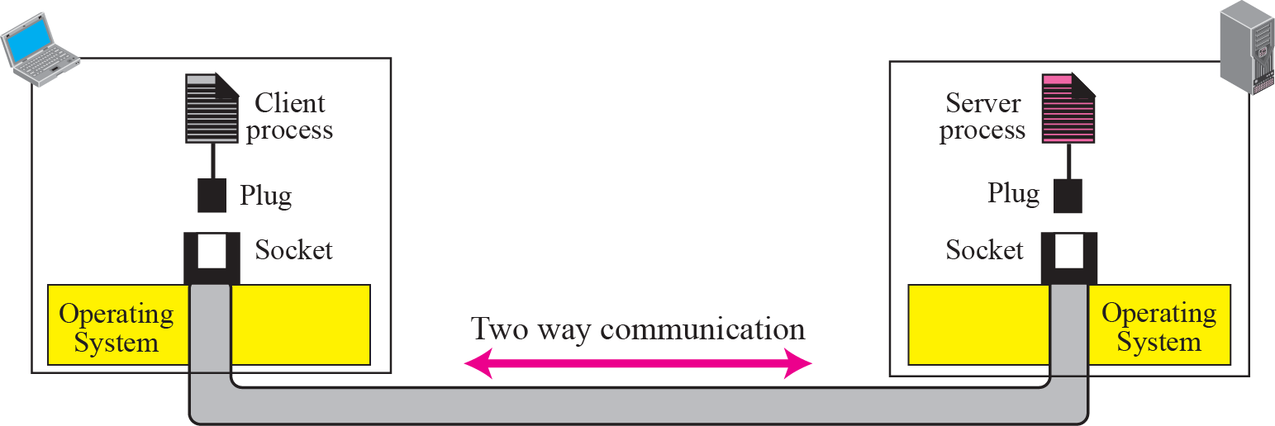
Figure 17.5 Concepts of sockets

Slide 13
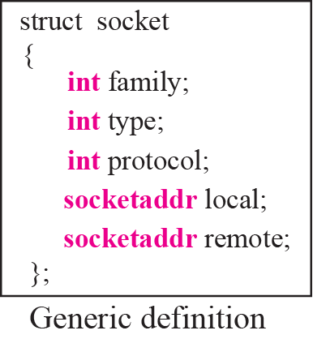
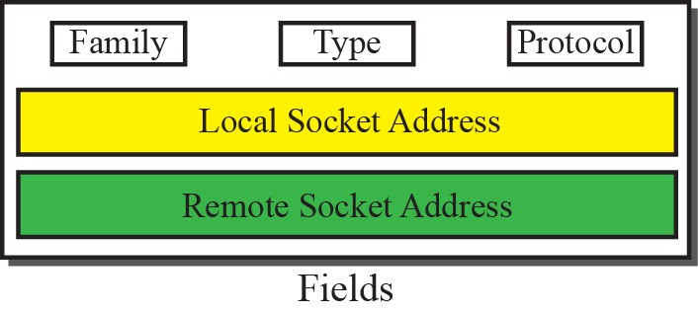
Figure 17.6 Socket data structure

Slide 14
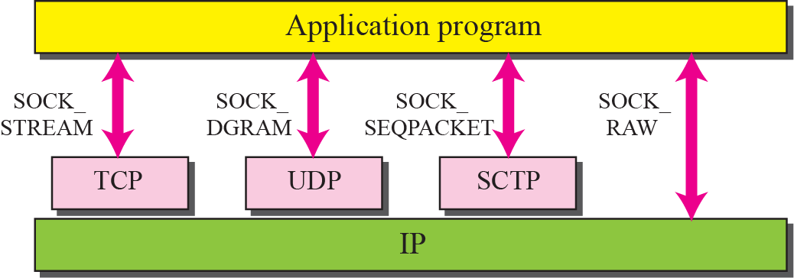
Figure 17.7 Socket types

Slide 15
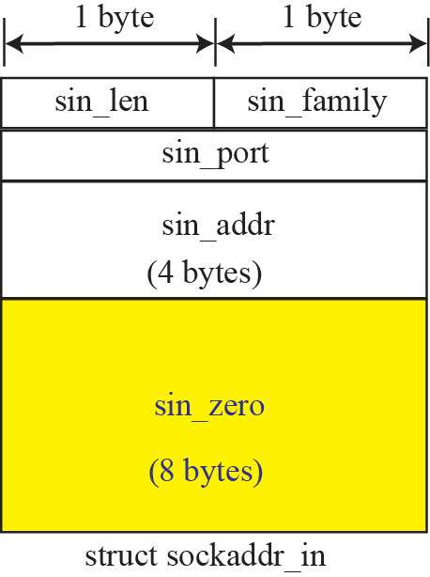
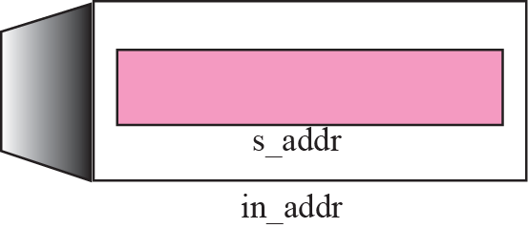
Figure 17.8 IPv4 socket address

Slide 16
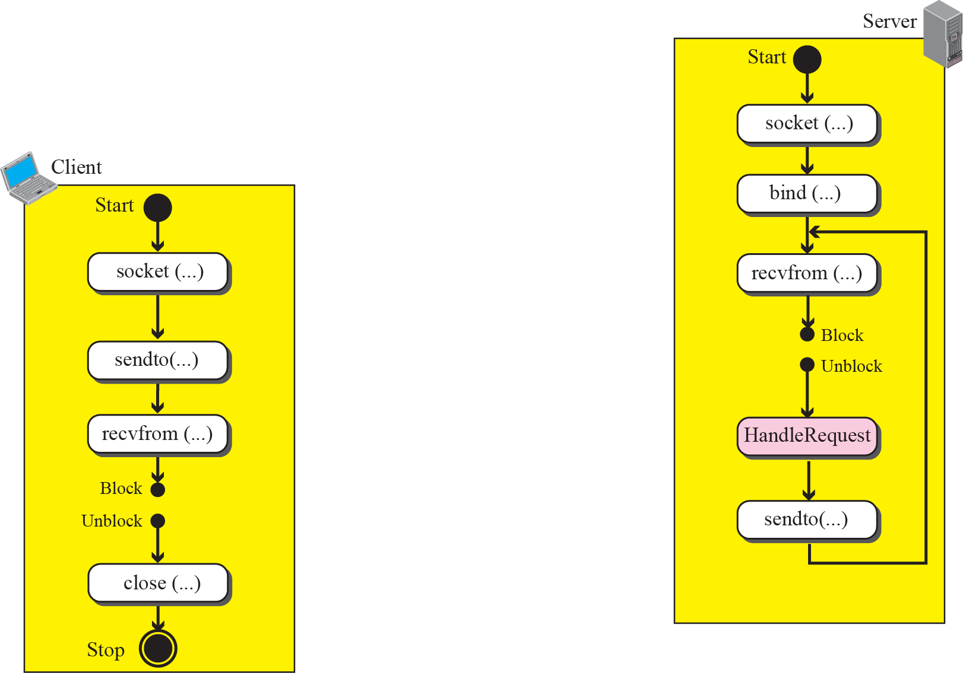
Figure 17.9 Connectionless iterative communication using UDP

Slide 17
Example 17.2
As an example, let us see how we can design and write two programs: an echo server and an echo server. The client sends a line of text to the server; the server sends the same line back to the client. Although this client/server pair looks useless, it has some applications. It can be used, for example, when a computer wants to test if another computer in the network is alive. To better understand the code in a program, we first give the layout of variables used in both programs as shown in Figure 17.10.

Slide 18
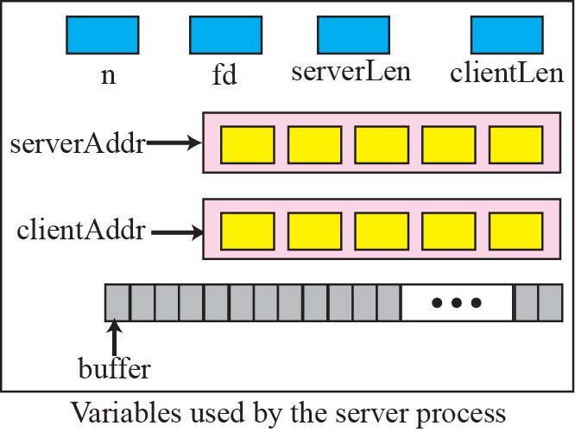
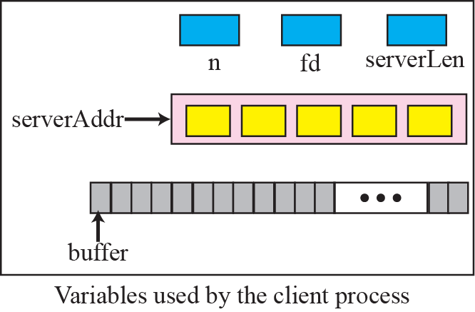
Figure 17.10 Variables used in echo server and echo client using UDP service

Slide 19
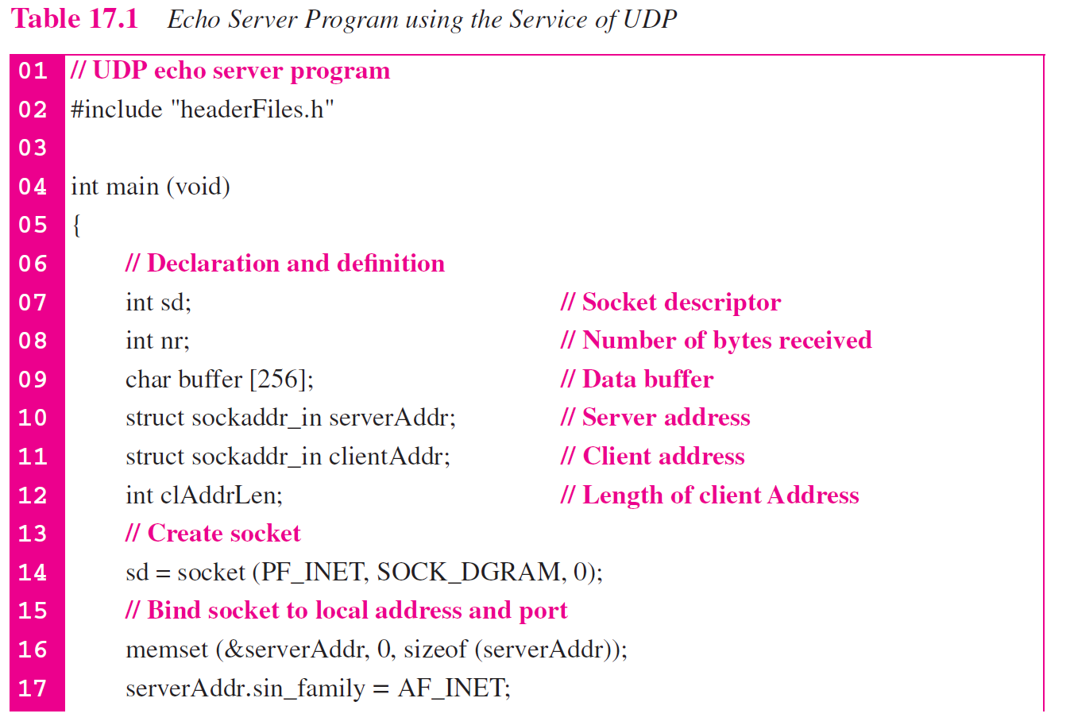

Slide 20
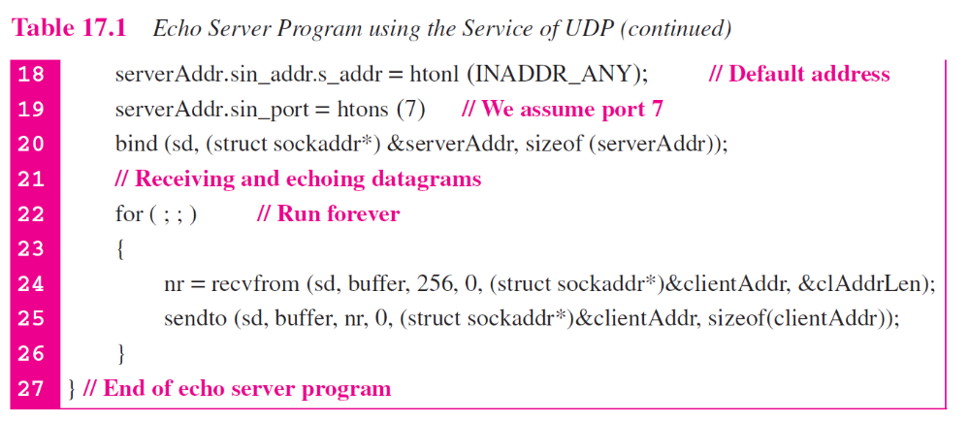

Slide 21
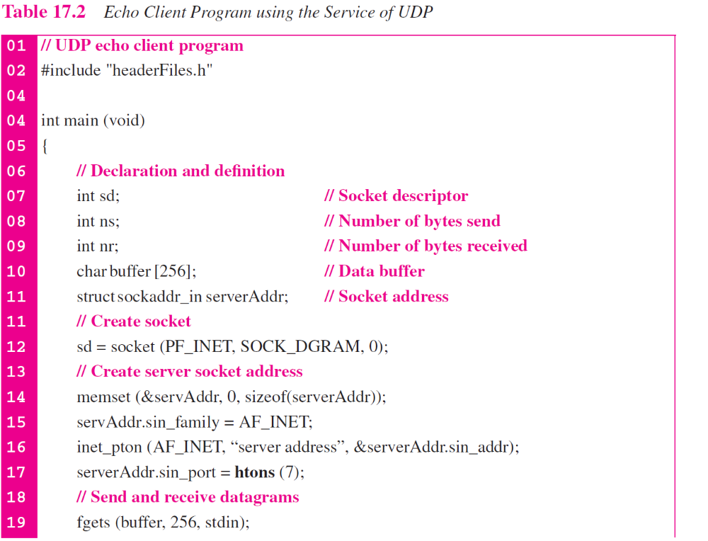

Slide 22
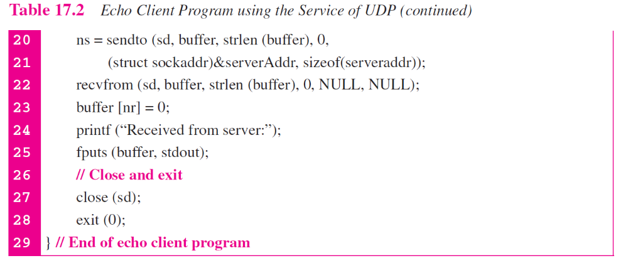

Slide 23
Note
To be complete, error-checking code needs to be added to both server
and client programs.

Slide 24
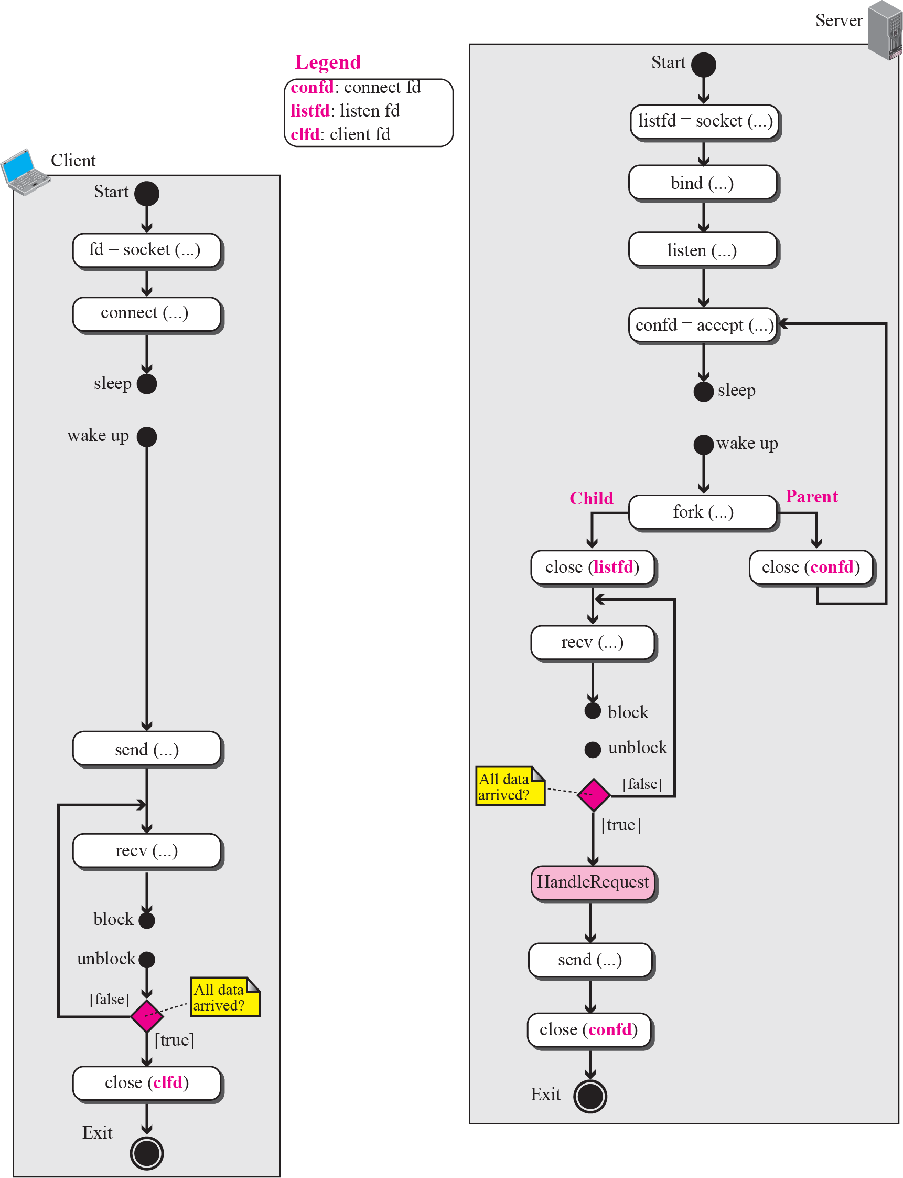



Figure 17.11 Flow diagram for connection-oriented, concurrent communication

Slide 25
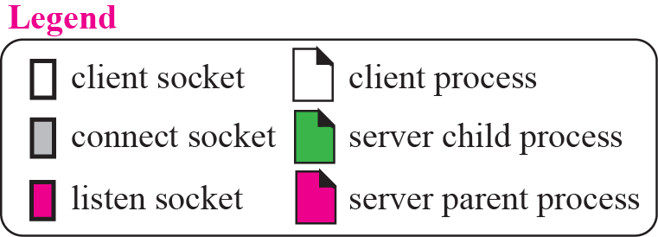
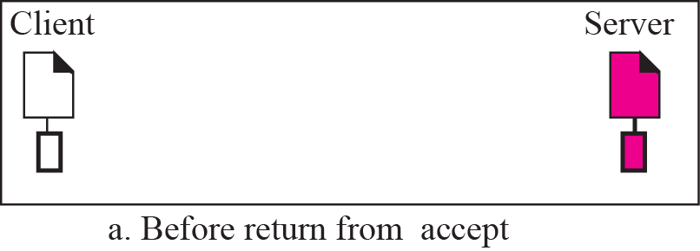
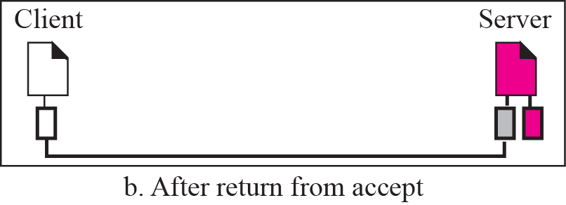
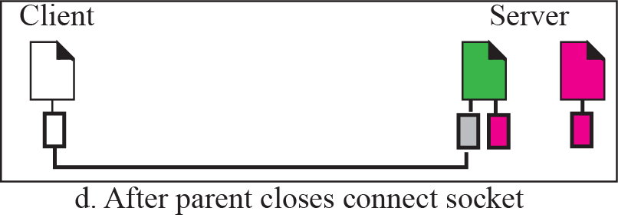
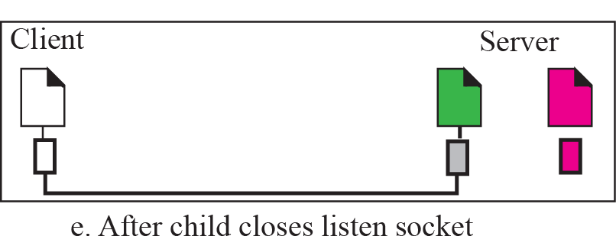
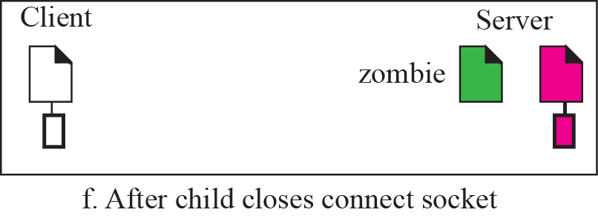
Figure 17.12 Status of parent and child processes with respect to the socket

Slide 26
Example 17.3
We want to write two programs to show how we can have an echo client and echo server using the services of TCP. Figure 17.13 shows the variables we use in these two programs. Since data may arrive in different chunks, we need pointers to point to the buffer. The first buffer is fixed and always points to the beginning of the buffer; the second pointer is moving to let the arrived bytes be appended to the end of the previous section.

Slide 27
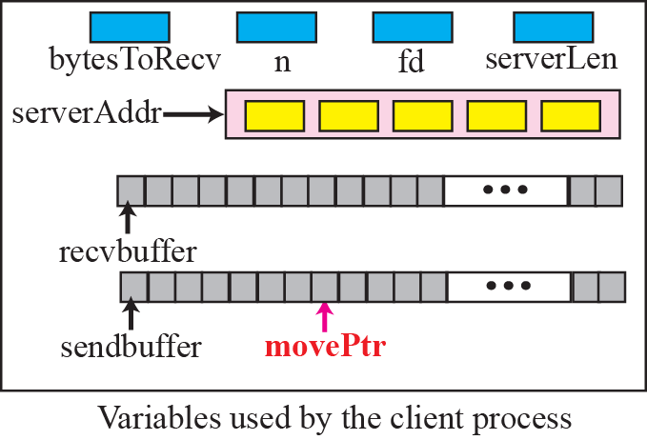
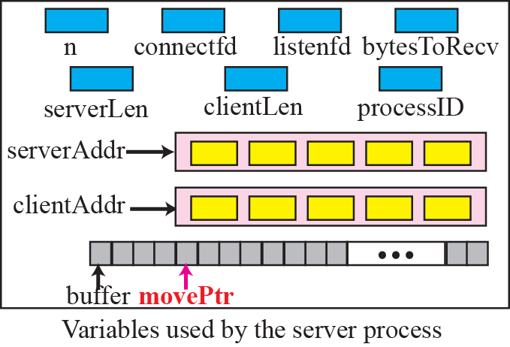
Figure 17.13 Variable used in echo client and echo sever using TCP

Slide 28
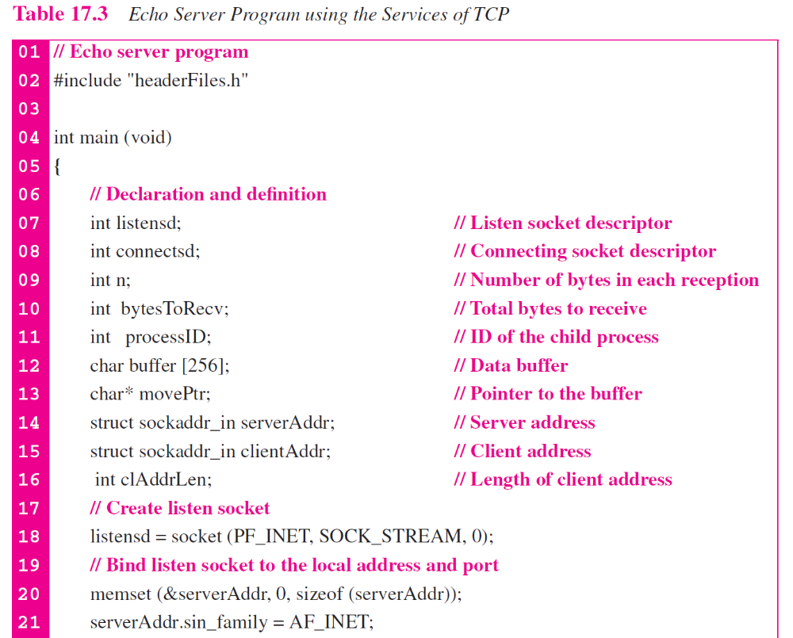

Slide 29
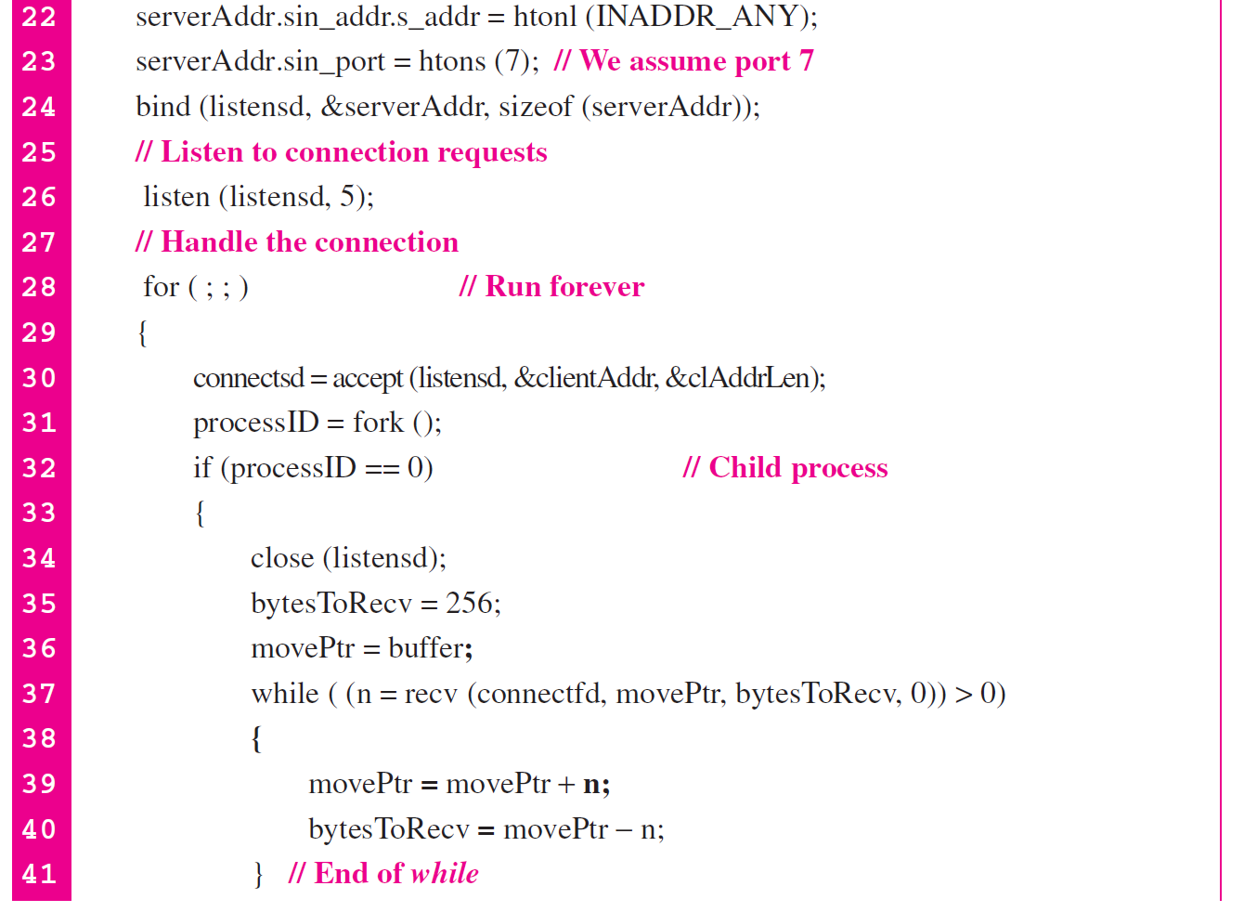

Slide 30
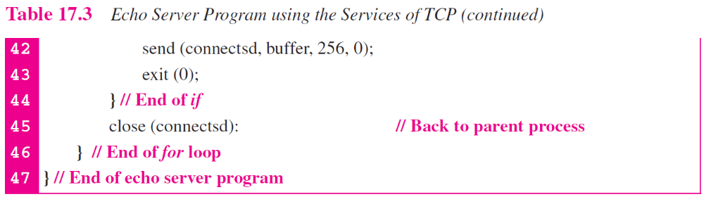

Slide 31
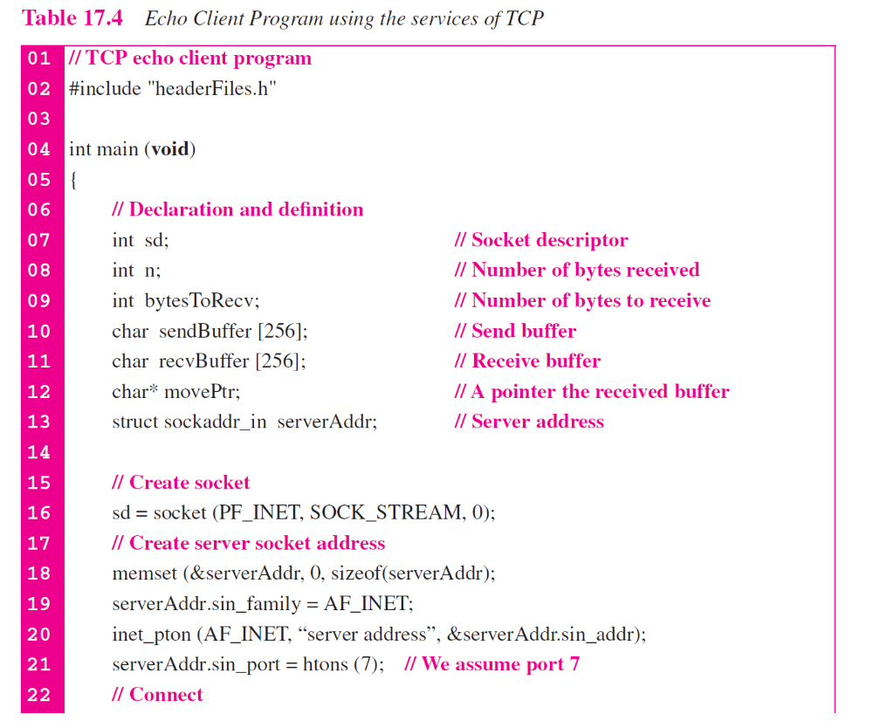

Slide 32
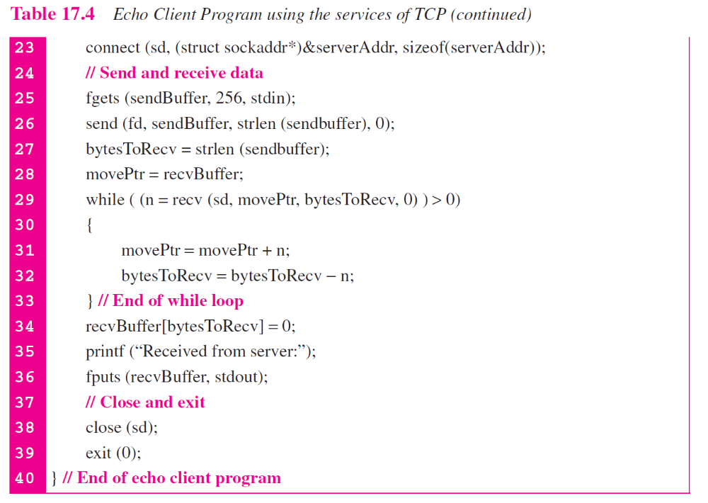

Slide 33
Note
In Appendix F we give some simple Java versions of programs in
Table 17.1 to 17.4

Slide 34
17-2 PEER-TO-PEER PARADIGM
Although most of the applications available in the Internet today use the client-server paradigm, the idea of using peer-to-peer (P2P) paradigm recently has attracted some attention. In this paradigm, two peer computers can communicate with each other to exchange services. This paradigm is interesting in some areas such file as transfer in which the client-server paradigm may put a lot of the load on the server machine. However, we need to mention that the P2P paradigm does not ignore the client-server paradigm; it is based on this paradigm.

